Slide 1
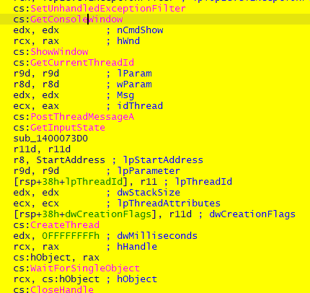
Dynamic and Static Analysis of ValleyRAT
Summary
Analyzed the malware samples on a WIN 11 Home machine by using tools like Wireshark, DiE, Process Monitor, etc.
Found out few domains in the network traffic and few malicious addresses redirecting to a Bogon IP Address.
Then found a lot of Registry Querys specifically related to svchost.exe, MpSigStub.exe, etc.
By running Autoruns I was able to identify the malicious driver that were ran by the threat actor to gain Persistence over the system.
Finally in the static analysis I was able to acquire a lot of knitty gritty details about the Injection Techniques used, Login Configuration (written in Chinese language), Dump samples, etc.
The threat actor is mainly Chinese and also sawn using Swarm protocol which Links to Hanghzhou in China.
Samples Used :-
MD5 Hash:- 3bfb43e677c7917baa371939bf051de2ea65dda59eb886f1f44d104293aa1c2f
MD5 Hash:- e0a43f6748661b87e390125baef5755be1c3d38a74b53c30371fbdeaa783fb94
Initial Access

Slide 2




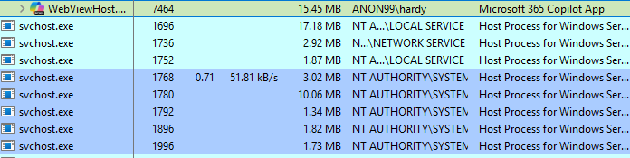
Fig 1 – Initial Access
At Initial access the malware will open the cd.exe and will execute WebViewHost.exe in the background, it masqueardes and runs svchost.exe but it is located in the Documents sections which completely
against the norm of svchost.exe and then it creates a lot of svchost.exe related to the following operations WriteFile, CopyFile, RegOpenKey, RegQueryKey and Closehandle.
Dynamic Analysis
Fig 2 – Fake svchost.exe
A lot of fake svchost.exe files are created at runtime of the RAT just for making noise and creating a
backdoor in the system. The above fig shows a lot of svchost.exe running simultaneously, that too on a Local service which is very suspicious because the afterwards they are Querying the Registry values and trying to access keys. The following Parent IDs are used to create noise and overshadow the backdoor:-
1696, 1736, 1752, 1768, 1780, 1792, 1896, 1996

Slide 3
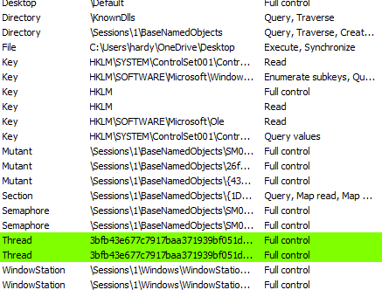
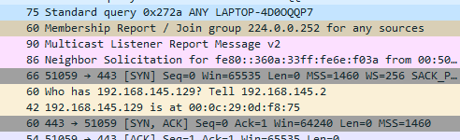
Fig 3 – Operations performed by the RAT
All the operations performed by the RAT and what control access it has got over the victim system by performing all the operations in the victim’s system it got hold of a lot of keys, semaphores, mutexes, etc.
Fig 4 – Membership Group Joining
By running Wireshark an Interesting thing comes up there is an IP 224.0.0.252 which redirects to a joining group of the for a membership account but the website is down. The IP redirects to 86 IP addresses after searching it in fofa search engine.

Slide 4

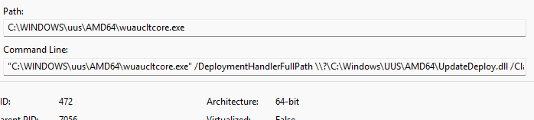
Fig 5 – Payload Downloader
The RAT downloads the payloads in the system using MpSigStub.exe which is an authentic process of windows and which is malware protection and it bypasses and passes on fake updates after for malware protection to Windows Users, which then in turn downloads the payload in the system.
Fig 6 – Triggering Reboot
The Windows trigger a reboot of the victim system by running the RAT and infecting the Update
Orchestrator. It updates the system and infects the machine Drivers specifically the drivers related to nfsi.sys, etc. After rebooting the system few times the file was not found in the system so it could be possible that it deletes after rebooting the system.
Fig 7 – Malicious Update
Malicious update of the victim’s system is done by using an windows auto update feature and deploying complete update by using wuaucltcore.exe.

Slide 5
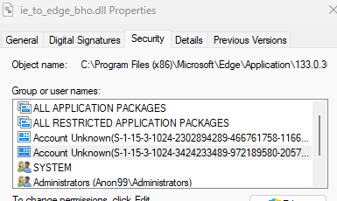
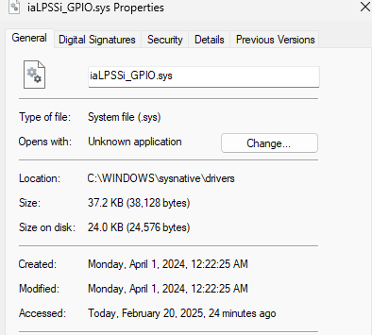
Fig 8 – Account Takeover
After execution of the RAT two unknown accounts have been detected to be login in the system
specifically Microsoft Edge accounts. So, the threat actor leverages Microsoft Edge to perform few of the Browser activities but the account names are Unknown just some specific CLSIDs are as follows:-
S-1-15 -3-1024-XXXXXXXXX-XXXXXXXXX-XXXXXXX S-1-15-3-1024-XXXXXXXXX-XXXXXXXXX-XXXXXXXX
Fig 10 – Driver vulnerable point
iaLPSSi_GPIO.sys (Intel(R) Serial IO GPIO Controller Driver) is the vulnerable driver which is exploited by the threat actor to gain access to the victim’s system by exploiting the driiver points of the system and gain admin access to the system.
Apart from that, Adobe is being run by the threat actor in the victim’s system but the file doesn’t contain any valuable information just collecting information about the epoch time of the packets used by
browsers and also the screentime.

Slide 6



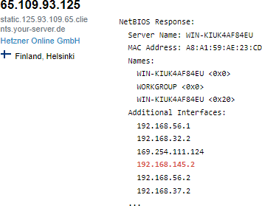


Fig 11 – IP Address redirecting to a Legitimate Server
The above address asking ‘Who has 192.168.145.2’ from the threat actor redirects to a Finnish server attributed to Hetzner Online GmbH. By searching it in Shodan I was able to identify that the malicious IP Address is connecting to the following server.
Fig 12 – Swarm Protocol used by RAT
What is Swarm Protocol ?
Swarm is a protocol for distributed data synchronization. Swarm is convergent (eventually-consistent) and spans to the client side. Technically, it does partially-ordered operation log synchronization. Swarm explicitly versions the data, every change is stamped with time and origin. Swarm supports:
end-to-end real-time incremental sync (op-based),
partial datasets on the client (of arbitrary selection, not "rooms"/"channels"),
client-side caching (as the data is versioned, a cache can always be incrementally updated),
ofline work (writes are queued, resubmitted on reconnection),
shared databases (where every change is attributed),

Slide 7
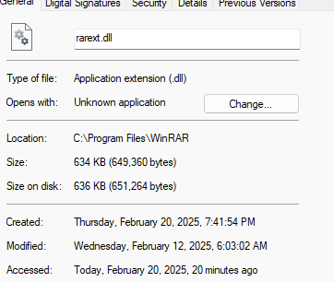


and lots of other exciting things.
While finding about the attributed servers for Swarm Protocol by using Fofa Search Engine I was able to identify 48 servers out of which 23 were Unique and out of which 5 of them were attributed to Chinese Servers which strongly indicates that the RAT might have used utmost one of them.
Fig 13 – Malicious WinRAR Downlaod
The RAT downloads malicious payloads in the form of WinRAR download and due to the sensitivity of
the information I cannot share the findings. It mostly downloads sensitive information like passport ids, Registered Vehicles Licenses, etc.
Fig 14 – Malicious DNS Servers
The DNS Servers names qq.ouyang770.com and ouyang.changle77.com are the malicious servers identified while running the malware.

Slide 8
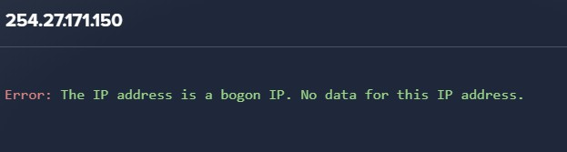
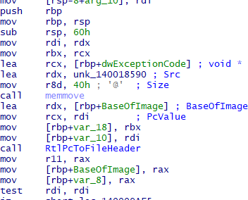
Fig 15 – Bogon IP Address used by Threat actor
A bogon IP Address used by the threat actor (254.27.171.150) to access the CDN.NET and redirecting to Microsoft websites.
In the network side after Running the malware for 20 Minutes it starts to perform a lot ARP packets
transfer and flooding it with same number of MAC addresses. So, the only reason it could be performing this is because of ARP Poisoning.
What is ARP Posoning ?
The ARP Poisoning, also known as ARP Spoofing, is a type of cyberattack that takes advantage of the ARP (Address Resolution Protocol). ARP is a protocol that maps an IP address to a MAC address within a local network. However, ARP lacks authentication mechanisms, and this is what the attack exploits.
The attacker sends fake ARP responses to a specific host on the network, thus linking the attacker’s MAC address to the IP address of another host, such as the network’s gateway. As a result, the target host sends all its network traffic to the attacker instead of the intended host
Static Analysis
Fig 16 – Retrieving PC Value from Base Image
What is RtlPcToFileHeader?

Slide 9

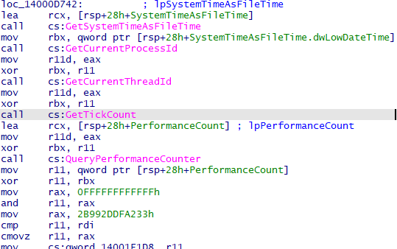
RtlPcToFileName() and RtlPcToFilePath() enable a driver to get the name and path of a kernel module respectively, from an address that points to the PE image of the module in memory. RtlPcToFileName() and RtlPcToFilePath() walk-through the list of KLDR_DATA_TABLE_ENTRY structures anchored at PsLoadedModuleList and determine if the given address (Pc) falls within the extents in
KLDR_DATA_TABLE_ENTRY.Base and KLDR_DATA_TABLE_ENTRY.Base +
KLDR_DATA_TABLE_ENTRY.SizeOfImage and if so, return information about the module.
RtlPcToFileName() returns the name of the driver form KLDR_DATA_TABLE_ENTRY.BaseDllName whereas RtlPcToFilePath() returns the full path to the driver from KLDR_DATA_TABLE_ENTRY.FullDllName.
RtlPcToFileHeader(), on the other hand, looks up the Pc using PsInvertedFunctionTable and returns the ImageBase and writes it to the location pointed to by BaseOfImage.
Fig 17 – IP and Domain addresses
The above are the IP Addresses and domains found by performing static analysis in IDA and using floss I was able to extract the domains and some encoded IP addresses such as 31.11.42.02:262 and 1.0.0.721:316 and also the Google IP Address 8.8.8.8:215
Fig 18 – Extracting Time

Slide 10
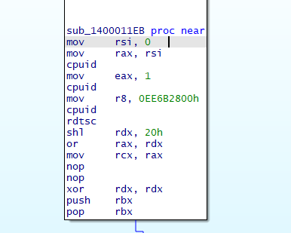
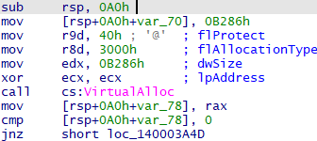
What is GetSystemTimeAsFileTime and GetTickCount ?
Retrieves the current system date and time. The information is in Coordinated Universal Time (UTC) format.
Retrieves the number of milliseconds that have elapsed since the system was started, up to 49.7 days.
Fig 19 – Anti- VM Techniques Used
What is cupid and rdtsc ?
CPUID: This instruction is used to identify the CPU you're running on. It provides details about the CPU’s capabilities and other features such as its model, manufacturer, and supported instructions. It’s quite handy for software that needs to adapt to different processors or optimize performance.
RDTSC (Read Time-Stamp Counter): This instruction reads the time-stamp counter of the CPU, which counts the number of clock cycles since the last reset. It's often used for performance monitoring, benchmarking, and timing because it provides a high-resolution timestamp.
Fig 20 – Execution of Shellcode

Slide 11
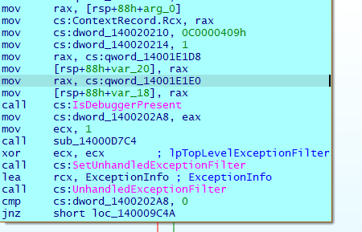
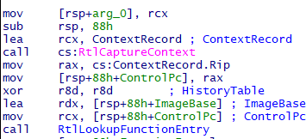
VirtualAlloc is a Windows API function that allocates memory in a process's virtual address space. It's often used in the execution of shellcode, which is a small piece of code used as the payload in the
exploitation of a software vulnerability.
Here's a basic outline of how VirtualAlloc is used in shellcode execution:
Allocate Memory: Use VirtualAlloc to allocate a region of memory with the
PAGE_EXECUTE_READWRITE attribute, which allows the memory to be executable.
Copy Shellcode: Copy the shellcode into the allocated memory region.
Execute Shellcode: Create a new thread that starts execution at the address of the allocated memory region containing the shellcode.
Fig 21 – Anti–Debug Technique used
IsDebuggerPresent is a Windows API function that checks if the calling process is being debugged. It’s often used as an anti-debugging technique in software to prevent reverse engineering and tampering. When called, it returns a non-zero value (TRUE) if a debugger is present; otherwise, it returns zero (FALSE).
Fig 22 – Capturing Screenshot of the machine

Slide 12
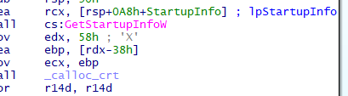
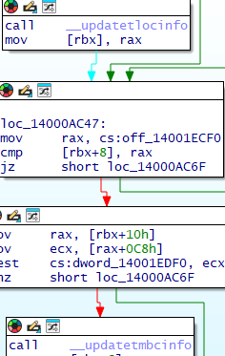
RtlCaptureContext is a Windows API function that captures the context of the calling thread. It retrieves a context record, which includes the processor-specific register data, such as the instruction pointer,
stack pointer, and other registers. This function is often used in debugging and exception handling to get a snapshot of the current state of the CPU.
Fig 23 – Extract OS Specifications
GetStartupInfoW is a Windows API function that retrieves the startup information of the calling process. This information is passed to the process by the operating system when the process is created. It's commonly used to access the startup parameters of a process, such as window position, size, and handles.
Fig 24 – Internal functions used by CRT
UpdateLocInfo and UpdateMBCInfo are internal functions used by the Microsoft C Runtime Library (CRT) to update locale and multibyte character information, respectively. These functions are not typically used directly by applications but are part of the CRT's internal mechanisms to handle locale-specific and multibyte character set (MBCS) operations.
1. UpdateLocInfo: This function updates the locale information used by the CRT. Locale information includes settings such as date and time formats, currency symbols, and other regional settings.
The CRT uses this information to provide locale-specific behavior for functions like printf, scanf, and others.

Slide 13
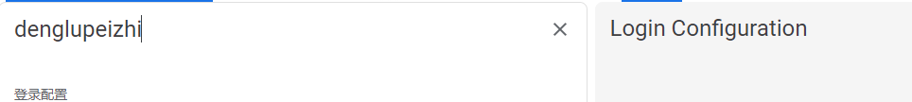
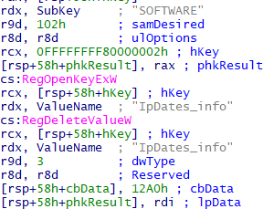
2. UpdateMBCInfo: This function updates the multibyte character information used by the CRT.
Multibyte character sets are used to represent characters in languages that have more
characters than can be represented in a single byte. The CRT uses this information to correctly handle multibyte character input and output.
These functions are part of the internal workings of the CRT and are not documented for direct use by applications. Instead, applications should use the standard locale and multibyte character functions provided by the CRT, such as setlocale, mbstowcs, and wcstombs.
Fig 25 – Chinese Language Used for Login Configuration
Login Configuration of the website has been located in the IDA code base.
Fig 26- Registry Entries
RegOpenKeyExW: This function opens the specified registry key. It allows you to access the key and perform operations on it.
RegDeleteValueW: This function removes a named value from the specified registry key
Conversion of Code in C++:-
#include <windows.h> #include <iostream>
int main() { HKEY hKey;

Slide 14
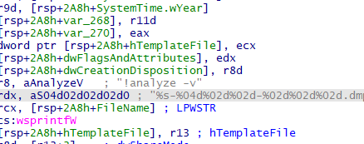
LONG result = RegOpenKeyExW(HKEY_CURRENT_USER, L"Software\\MyApp", 0, KEY_SET_VALUE, &hKey);
if (result == ERROR_SUCCESS) {
result = RegDeleteValueW(hKey, L"MyValue"); if (result == ERROR_SUCCESS) {
std::wcout << L"Registry value deleted successfully." << std::endl;
} else {
std::wcout << L"Failed to delete registry value. Error: " << result << std::endl;
}
RegCloseKey(hKey);
} else {
std::wcout << L"Failed to open registry key. Error: " << result << std::endl;
}
return 0;
}
Fig 27 – swprintfw function for dumping file
The above figure show that it is dumping the file in an temp file which will also create a directory.
swprintf can be used to format data and write it to a file, though it's not commonly used for dumping binary data. For that purpose, functions like fwrite are more suitable. However, swprintf can be handy
for creating formatted text output.

Slide 15


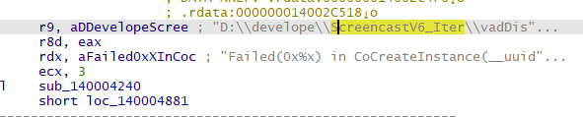
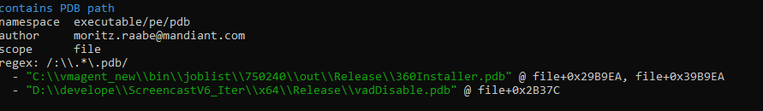
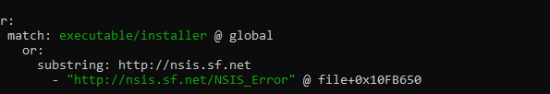
Fig 28 – Infected Victims
By searching through IDA I was able to extract few of the victims that were infected by the RAT.
Fig 29 – Screencast and joblist PDB path
Creating a screencast involves recording your screen activity, along with optional audio narration, to
create a video tutorial or presentation. It also created and D drive folder and disabling the PDB installer as it contains PDB Path.
Fig 30 – NSIS_ERROR

Slide 16
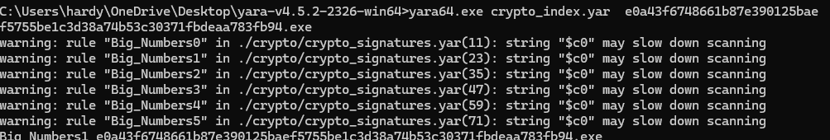
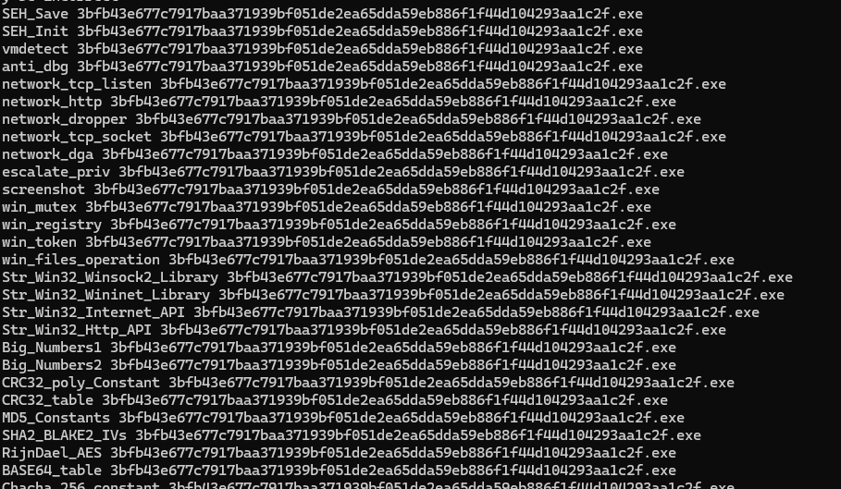
The NSIS (Nullsoft Scriptable Install System) error typically occurs when there's an issue with the
installer you're trying to run. This error indicates that the installer has failed its self-check, which means the installation files might be corrupted or incomplete.
Fig 31 – Crypto are of 32 sized numbers
By using YARA Tool I was able to find that the crypto are of 32 sized numbers.
Fig 32 – Operations of the RAT
The above are the operations performed by the RAT

Slide 17
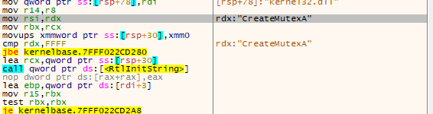



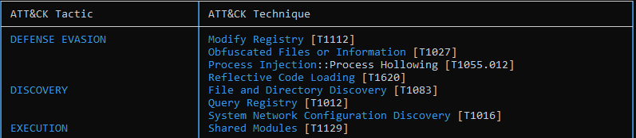
Fig 33 – Mutex for the RAT
Mutex for the RAT – 26f3475fc22
Fig 34 – Shim Logs
The SepApplyDebugPolicy function, called early in SE_InitializeEngine, is responsible for initializing some global variables related to logging. It reads two environment
variables, SHIM_DEBUG_LEVEL and SHIMENG_DEBUG_LEVEL, into global variables controlling the verbosity of shims' logs and AppHelp itself's logs respectively. Level 5 produces messages of all detail levels including "trace." These logs seem to be designed for consumption via ETW Trace Logging, but I was unable to record any relevant events with WPR
MITRE ATT&CK Techniques

Slide 18
Fig 35 – MITRE ATT&CK Techniques Used by the RAT
IOCs
IP Addresses
31.11.42.02:262
1.0.0.721:316
224.0.0.252
192.168.145.2
65.109.93.125
8.8.8.8:215
254.27.171.150 (Bogon IP Address)
Mutex
26f3475fc22
Domain Servers qq.ouyang770.com ouyang.changle77.com
Conclusion
So, from the above we can conclude a lot of details performed by the ValleyRAT and found some interesting artifacts and gathered a lot of valuable information.
Still a lot of information has been left out and lot of samples to reverse engineer. This are just a few information about the RAT.

